Slide 1


Spot the Fire V3.0 - EarthWise
Members -
Ahana Dutta
Tvisha Trivedi

Slide 2
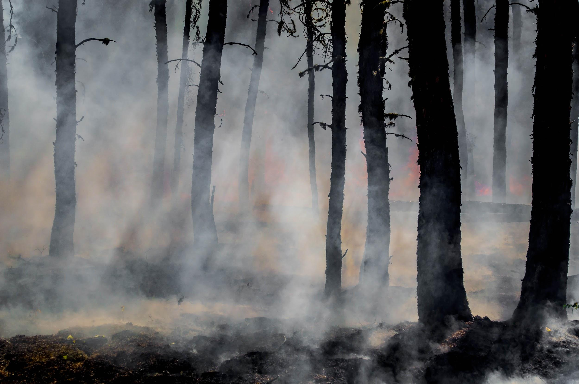
Introduction
WHO has defined wildfires as “An unplanned fire that burns in a natural area such as a forest, grassland, or prairie.”
Most of the time, wildfires are caused as a result of natural phenomenons like lightning, extreme heat, high temperatures during summer, and drought. However, wildfires starting due to human activities are also not unheard of. Almost half of the time, reasons that cause these fires are unknown.
Wildfires have impacted local ecology, animals, farmlands, regional air quality, properties and people.
Prediction of wildfires thus become an important aspect in controlling these losses and also assists in providing time to take necessary safety measures.

Slide 3

Goal
This project aims to provide a supervised machine learning model that can help in the prediction of wildfires.
To do that we took the areas where previous fires had taken place.
Apart from that we also took the areas where fire had not spread widely.
We took brightness of each region of fire and created a model where using the brightness or intensity of the area, a prediction of whether fire had escalated at that place or not could be made.

Slide 4
Working
To explain the working of the project code, we have listed out the steps covered:
Plot histogram using brightness
Find quantile of brightness, latitude and longitude
Divide brightness in low, high and extreme on the basis of value and add this as a column
Categorize area on the basis of latitude and longitude
Preprocess the data by replacing object value with integer value
Apply different machine learning algorithms 6.1. K - Neighbours 6.2. SVC 6.3. Random Forest 6.4. Logistic Regression 6.5. SGD

Slide 5
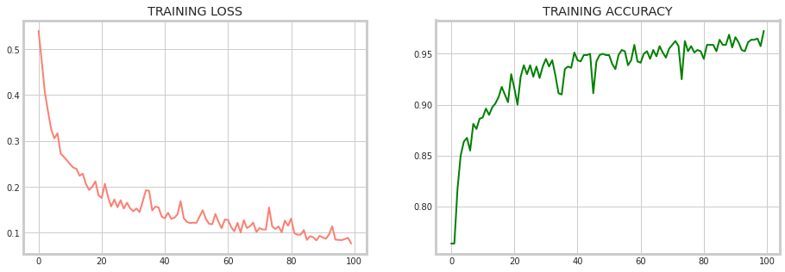
Results
Algorithm | Accuracy
K Nearest Neighbours | 95.28
Support Vector Classifier | 94.93
Random Forest | 95.95
Logistic Regression | 94.93
Stochastic Gradient Descent | 94.93
Final model was used to predict fire from non fire.
Final accuracy scores were calculated as such:
Training loss and accuracy was plotted as such:

Slide 6
Future Scope
1. Fire weather forecasts and moisture prediction
2. Proposal of prediction within a cluster which performs aggregation
3. Application of convolution neural network and autoencoder for prediction
4. Fuzzy-based forest fire risk controller. A fuzzy-based forest fire controller to analyse measured environmental information, for estimating the existence of forest fire risks, detecting recent wildfire incidents, and activating environmental alerts.
5. Integrating various elements into a web service and a mobile application to improve the coordination of emergency corps.
6. Blockchain as a novel technology that might be used to favour the planning of WSN (Wireless Sensor Network) distribution in order to propose decentralized schemes for authenticating new node.

Slide 7
THANK YOU

